Slide 1
CSE 477: Introduction to Computer Security
Lecture – 7
Course Teacher: Dr. Md Sadek Ferdous
Assistant Professor, CSE, SUST
E-mail: ripul.bd@gmail.com

Slide 2
Outline
AES

Slide 3
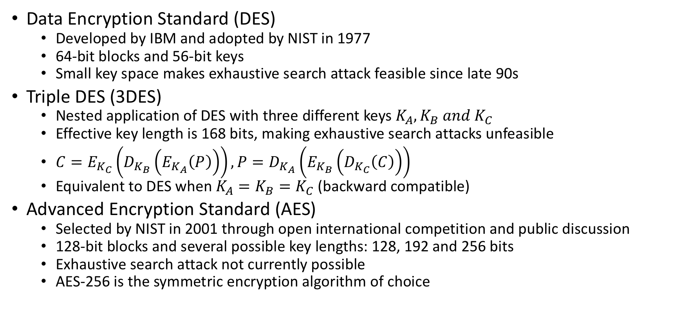
Block cipher in practice
Data Encryption Standard (DES)
Developed by IBM and adopted by NIST in 1977
64-bit blocks and 56-bit keys
Small key space makes exhaustive search attack feasible since late 90s
Triple DES (3DES)
Nested application of DES with three different keys $K_{A}, K_{B} and K_{C}$
Effective key length is 168 bits, making exhaustive search attacks unfeasible
$C=E_{K_{C}}\left(D_{K_{B}}\left(E_{K_{A}}\left(P\right)\right)\right), P=D_{K_{A}}\left(E_{K_{B}}\left(D_{K_{C}}\left(C\right)\right)\right)$
Equivalent to DES when $K_{A}=K_{B}=K_{C}$(backward compatible)
Advanced Encryption Standard (AES)
Selected by NIST in 2001 through open international competition and public discussion
128-bit blocks and several possible key lengths: 128, 192 and 256 bits
Exhaustive search attack not currently possible
AES-256 is the symmetric encryption algorithm of choice

Slide 4
AES
NIST put out a public call for a replacement of the symmetric encryption algorithm DES in 1997
Five finalists: Rijndael (“Rhine doll”), designed by Joan Daemen and Vincent Rijmen, MARS from IBM, RC6 from RSA Security, Serpent by Ross Anderson, Eli Biham, and Lars Knudsen and Twofish by a team led by Bruce Schneier
Rijndael was ultimately chosen as the new standard the Advanced Encryption Standard (AES)
AES is a block cipher that operates on 128-bit blocks
designed to be used with keys that are 128, 192, or 256 bits long, yielding ciphers known as AES-128, AES-192, and AES-256

Slide 5
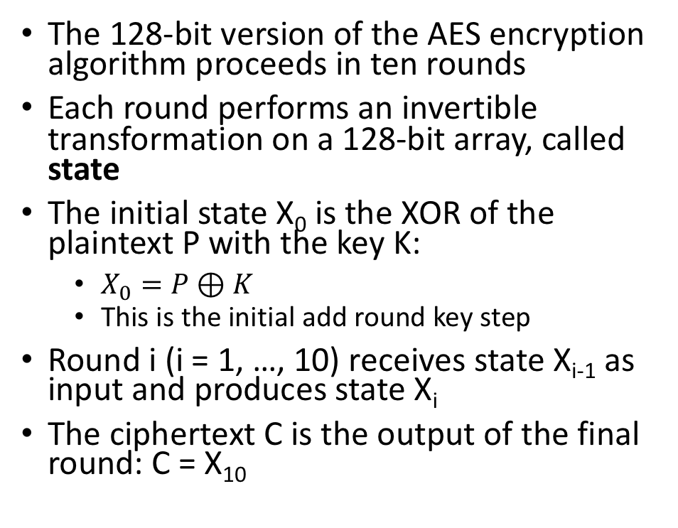
AES
The 128-bit version of the AES encryption algorithm proceeds in ten rounds
Each round performs an invertible transformation on a 128-bit array, called state
The initial state X₀ is the XOR of the plaintext P with the key K:
$X_{0}=P⊕K$
This is the initial add round key step
Round i (i = 1, …, 10) receives state X_{i-1} as input and produces state X_{i}
The ciphertext C is the output of the final round: C = X₁₀

Slide 6
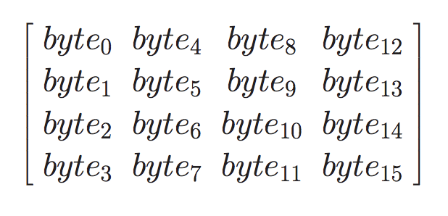
AES
To provide some structure to the 128-bit blocks it operates on, the AES algorithm views each such block, starting with the 128-bit block of plaintext, as 16 bytes of 8 bits each
This is arranged in column-major order into a 4 × 4 matrix as follows:
AES also has the notion of a word consisting of four bytes, that is 32 bits
Therefore, each column of the state array is a word, as is each row
Each round of processing works on the input state array and produces an output state array

Slide 7
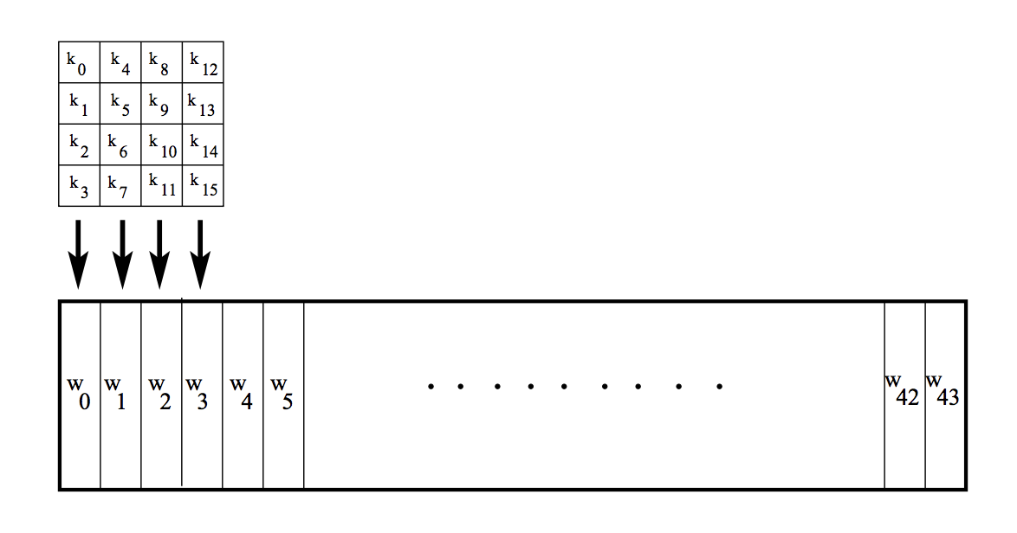
AES – Key Expansion
Assuming a 128-bit key, the key is also arranged in the form of an array of 4 × 4 bytes
As with the input block, the first word from the key fills the first column of the array, and so on
The four column words of the key array are expanded into a schedule of 44 words
Each round consumes four words from the key schedule
The figure depicts the arrangement of the encryption key in the form of 4-byte words and the expansion of the key into a key schedule consisting of 44 4-byte words
Of these, the first four words are used for adding to the input state array before any round-based processing can begin, and the remaining 40 words used for the ten rounds of processing that are required for the case a 128-bit encryption key.

Slide 8
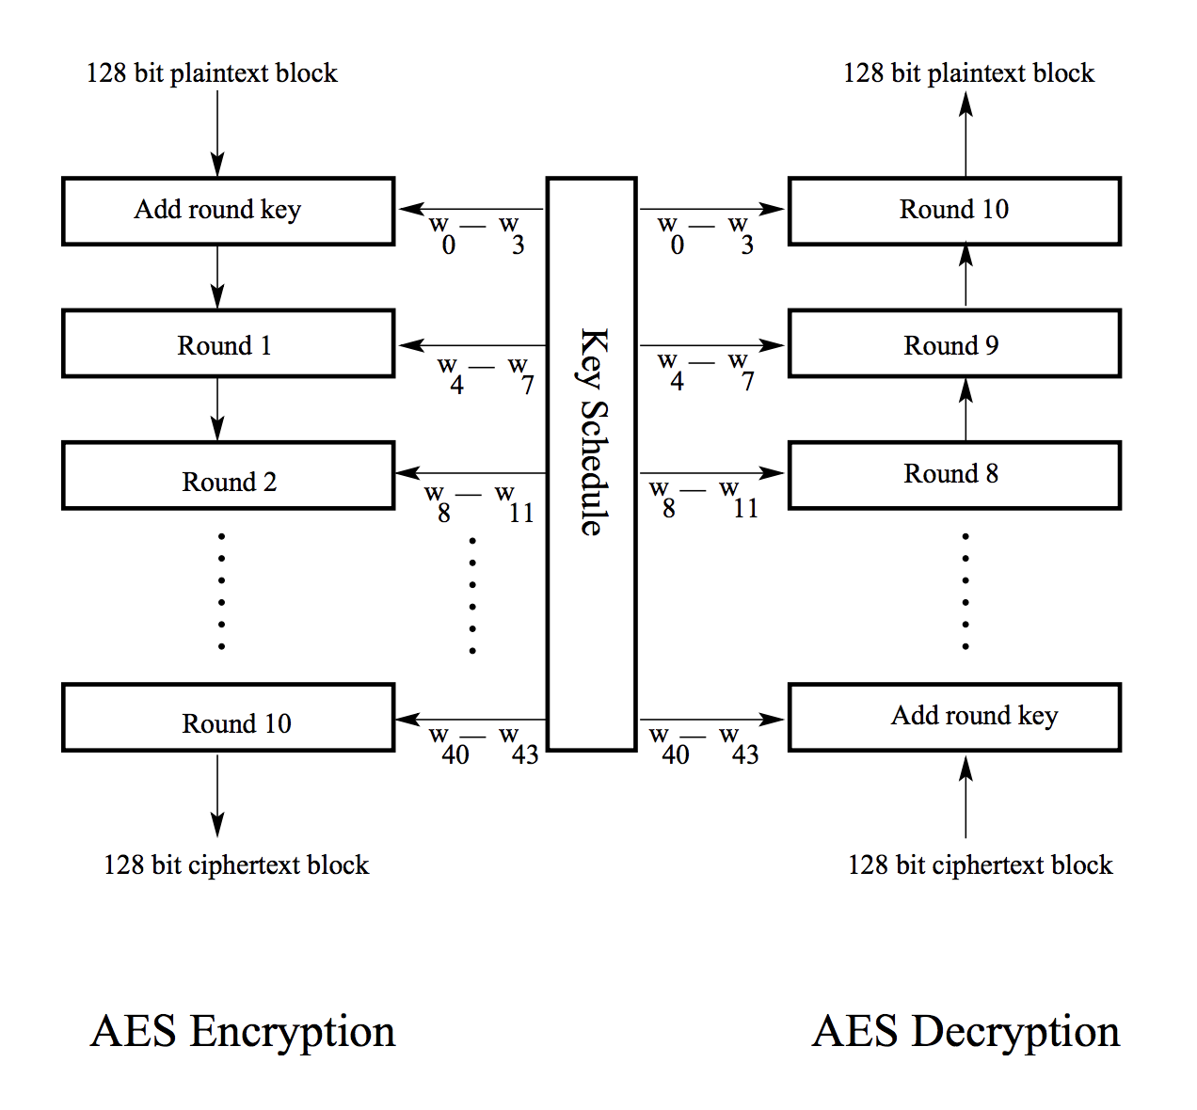
AES – Overall Encryption and Decryption

Slide 9
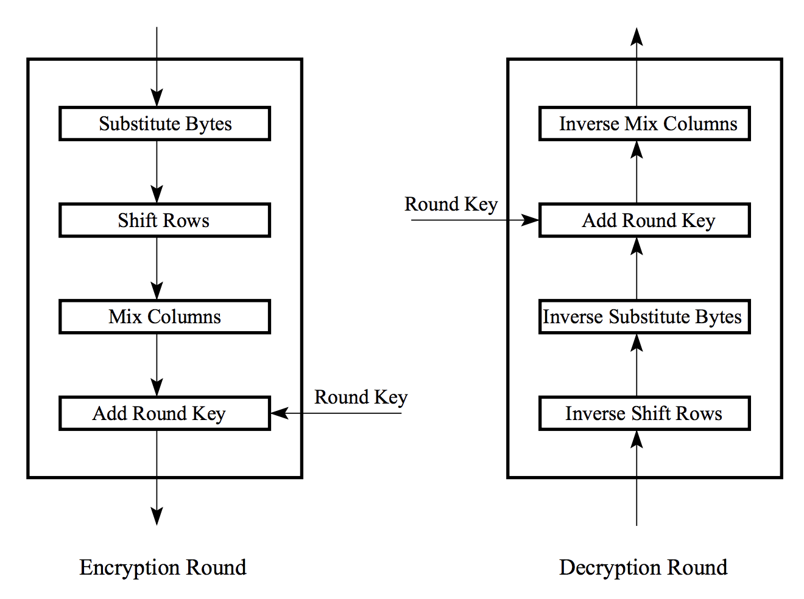
AES
Each round is built from four basic steps:
SubBytes step: an S-box substitution step
ShiftRows step: a permutation step
MixColumns step: a matrix multiplication step
AddRoundKey step: an XOR step with a round key derived from the 128-bit encryption key
For encryption and decryption, the sequence of these steps change according to the side figure

Slide 10
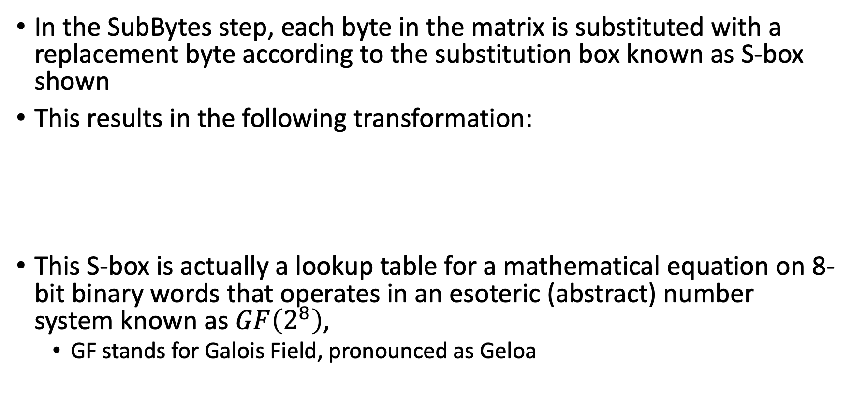
AES – SubBytes Step
In the SubBytes step, each byte in the matrix is substituted with a replacement byte according to the substitution box known as S-box shown
This results in the following transformation:
This S-box is actually a lookup table for a mathematical equation on 8-bit binary words that operates in an esoteric (abstract) number system known as $GF\left(2^{8}\right)$,
GF stands for Galois Field, pronounced as Geloa

Slide 11
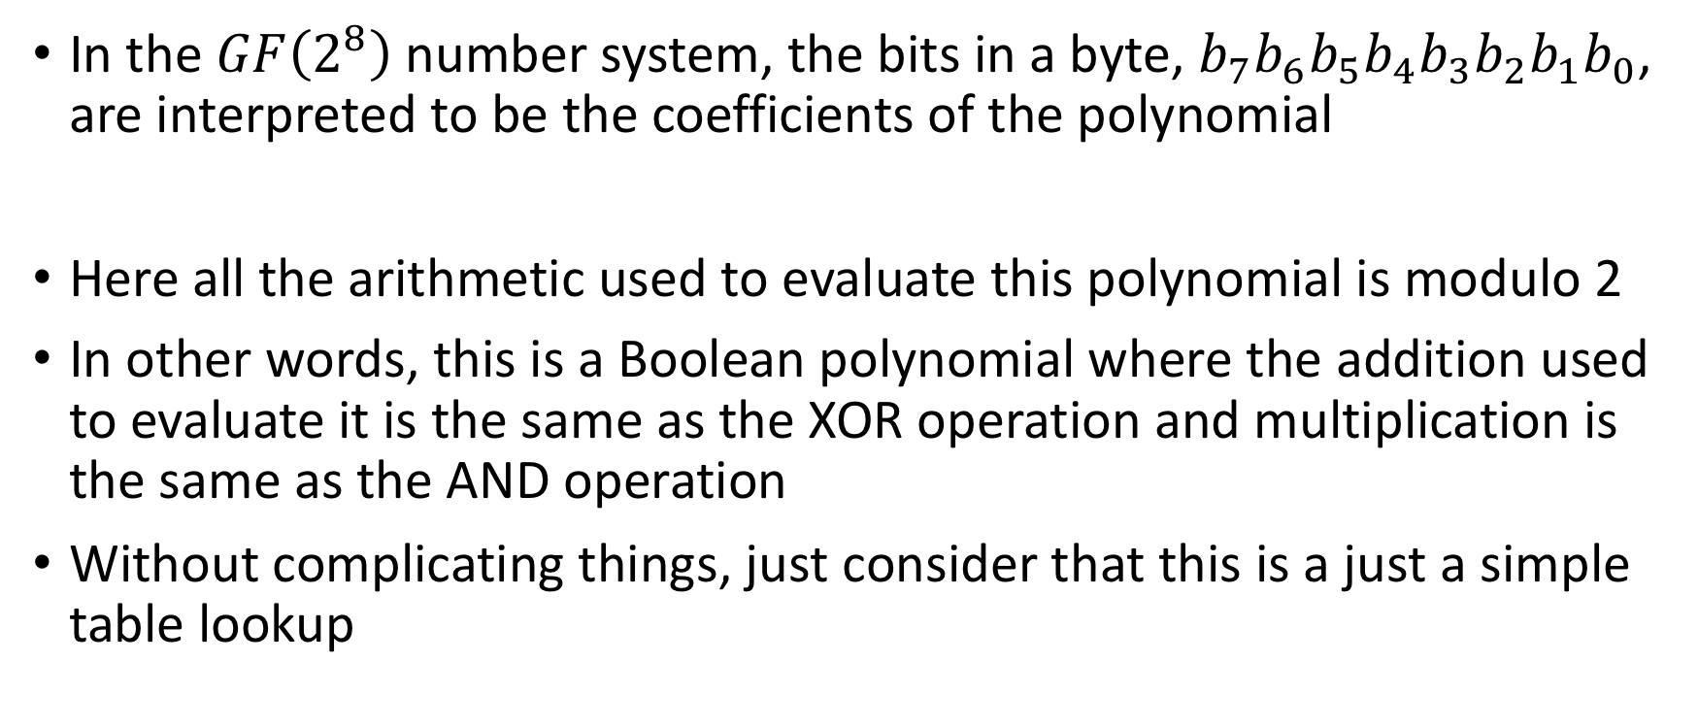
AES – SubBytes Step
In the $GF\left(2^{8}\right)$number system, the bits in a byte, $b_{7}b_{6}b_{5}b_{4}b_{3}b_{2}b_{1}b_{0}$, are interpreted to be the coefficients of the polynomial
Here all the arithmetic used to evaluate this polynomial is modulo 2
In other words, this is a Boolean polynomial where the addition used to evaluate it is the same as the XOR operation and multiplication is the same as the AND operation
Without complicating things, just consider that this is a just a simple table lookup

Slide 12
AES – SubBytes Step

Slide 13
AES – ShiftRows Step
The ShiftRows step is a simple permutation, which has the effect of mixing up the bytes in each row of the 4 × 4 matrix output from the SubBytes step
The permutation amounts to a cyclical shift of each row of the 4 × 4 matrix so that the first row is shifted left by 0, the second is shifted left by 1, the third is shifted left by 2, and the fourth is shifted left by 3, as follows:

Slide 14
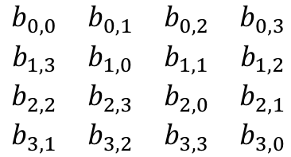
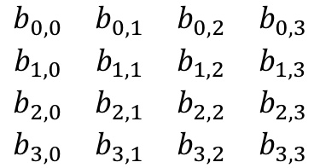
AES – ShiftRows Step
For decryption, the corresponding step shifts the rows in exactly the opposite fashion
The first row is left unchanged, the second row is shifted to the right by one byte, the third row to the right by two bytes, and the last row to the right by three bytes, all shifts being circular
$$\begin{matrix}b_{0,0} & b_{0,1} & b_{0,2} & b_{0,3} \\ b_{1,0} & b_{1,1} & b_{1,2} & b_{1,3} \\ b_{2,0} & b_{2,1} & b_{2,2} & b_{2,3} \\ b_{3,0} & b_{3,1} & b_{3,2} & b_{3,3}\end{matrix}$$
$$\begin{matrix}b_{0,0} & b_{0,1} & b_{0,2} & b_{0,3} \\ b_{1,3} & b_{1,0} & b_{1,1} & b_{1,2} \\ b_{2,2} & b_{2,3} & b_{2,0} & b_{2,1} \\ b_{3,1} & b_{3,2} & b_{3,3} & b_{3,0}\end{matrix}$$

Slide 15
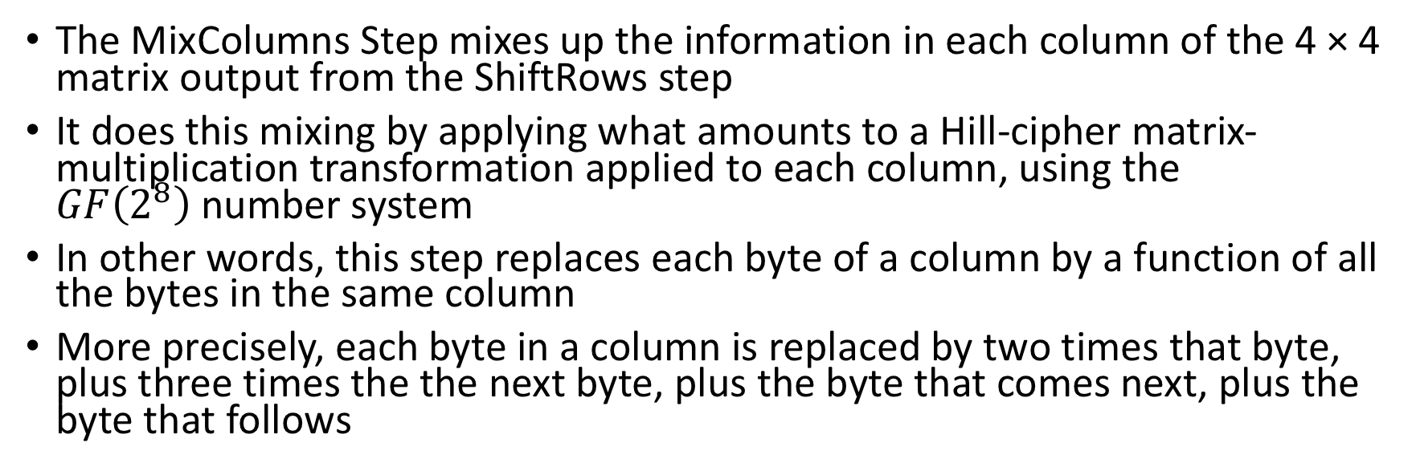
AES – MixColumns Step
The MixColumns Step mixes up the information in each column of the 4 × 4 matrix output from the ShiftRows step
It does this mixing by applying what amounts to a Hill-cipher matrix-multiplication transformation applied to each column, using the $GF\left(2^{8}\right)$number system
In other words, this step replaces each byte of a column by a function of all the bytes in the same column
More precisely, each byte in a column is replaced by two times that byte, plus three times the the next byte, plus the byte that comes next, plus the byte that follows

Slide 16
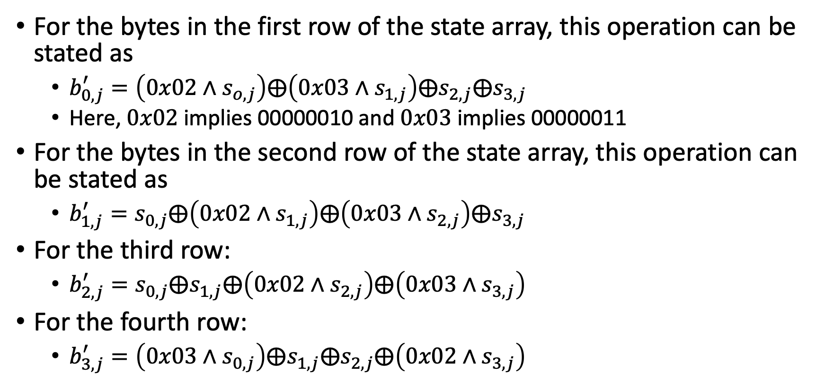
AES – MixColumns Step
For the bytes in the first row of the state array, this operation can be stated as
$b_{0,j}^{′}=\left(0x02∧s_{o,j}\right)⨁\left(0x03∧s_{1,j}\right)⨁s_{2,j}⨁s_{3,j}$
Here, $0x02$implies 00000010 and $0x03$ implies 00000011
For the bytes in the second row of the state array, this operation can be stated as
$b_{1,j}^{′}=s_{0,j}⨁\left(0x02∧s_{1,j}\right)⨁\left(0x03∧s_{2,j}\right)⨁s_{3,j}$
For the third row:
$b_{2,j}^{′}=s_{0,j}⨁s_{1,j}⨁\left(0x02∧s_{2,j}\right)⨁\left(0x03∧s_{3,j}\right)$
For the fourth row:
$b_{3,j}^{′}=\left(0x03∧s_{0,j}\right)⨁s_{1,j}⨁s_{2,j}⨁\left(0x02∧s_{3,j}\right)$

Slide 17
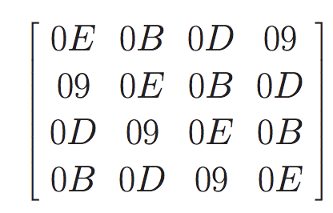
AES – MixColumns Step
For decryption, the following matrix is multiplied with the 4 x 4 matrix

Slide 18
AES – AddRoundKey Step
In the AddRoundKey step, we exclusive-or the result from previous steps with a set of keys derived from the 128-bit secret key
The operation of the AddRoundKey step, therefore, can be expressed as follows:
The critical part of performing this step is determining how the matrix of keys, k_{i,j}, for this round, are derived from the single 128-bit secret key, K

Slide 19
AES – Key Expansion
Each round has its own round key that is derived from the original 128-bit encryption key
One of the four steps of each round, for both encryption and decryption, involves XORing of the round key with the state array
The AES Key Expansion algorithm is used to derive the 128- bit round key for each round from the original 128-bit encryption key
The logic of the key expansion algorithm is designed to ensure that if you change one bit of the encryption key, it should affect the round keys for several rounds
At first, the algorithm first arranges the 16 bytes of the encryption key in the form of a 4×4 array of bytes, similar to the plain text

Slide 20
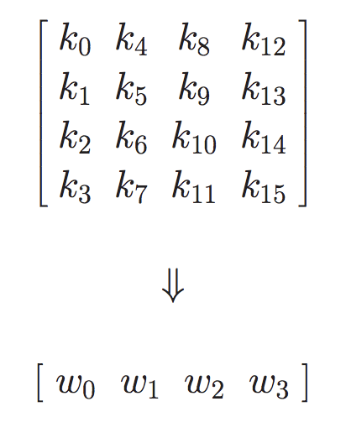
AES – Key Expansion
The first four bytes of the encryption key constitute the word w₀, the next four bytes the word w₁, and so on
The algorithm subsequently expands the words [w₀, w₁, w₂, w₃] into a 44-word key schedule that can be labelled w₀, w₁, w₂, w₃................., w₄₃
Of these, the words [w₀, w₁, w₂, w₃] are bitwise XOR’ed with the input block before the round-based processing begins
The remaining 40 words of the key schedule are used four words at a time in each of the 10 rounds
The above two statements are also true for decryption in reverse order

Slide 21
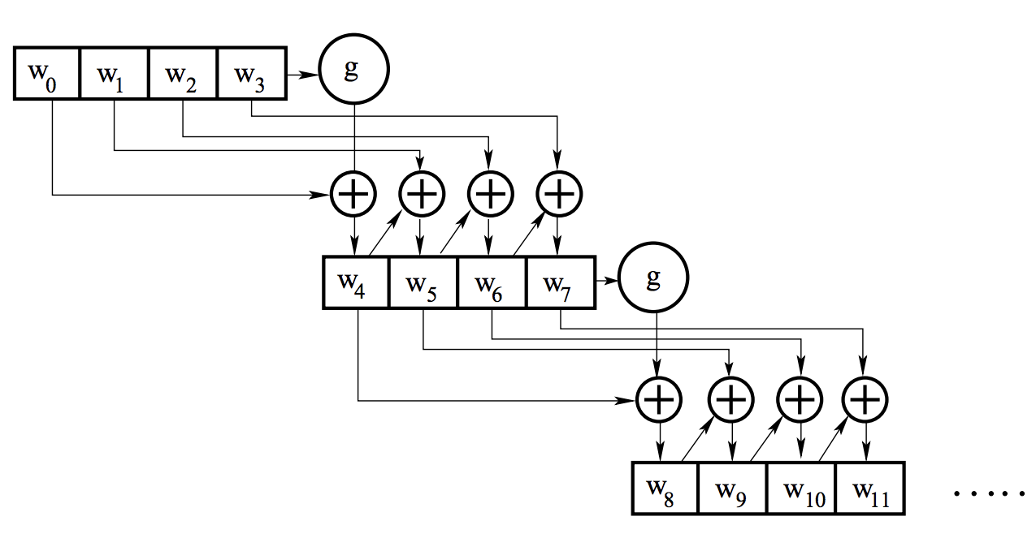
AES – Key Expansion
The key expansion takes place on a four-word to four-word basis, in the sense that each grouping of four words decides what the next grouping of four words will be

Slide 22
AES – Key Expansion
Let’s say that we have the four words of the round key for the i^{th} round: w_{i} w_{i+1} w_{i+2} w_{i+3}
For these to serve as the round key for the i^{th} round, i must be a multiple of 4
These will obviously serve as the round key for the (i/4)^{th} round
For example, w₄, w₅, w₆, w₇ is the round key for round 1, the sequence of words w₈, w₉, w₁₀, w₁₁ the round key for round 2, and so on
Now we need to determine the words w_{i+4} w_{i+5} w_{i+6} w_{i+7} from the words w_{i} w_{i+1} w_{i+2} w_{i+3}

Slide 23
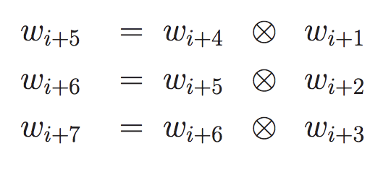
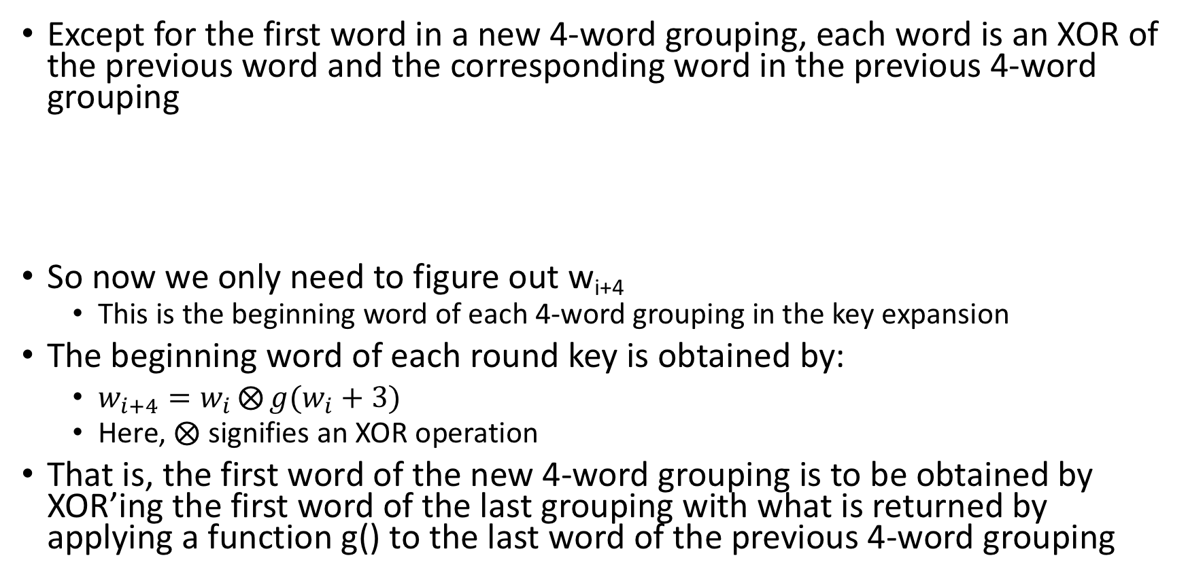
AES – Key Expansion
Except for the first word in a new 4-word grouping, each word is an XOR of the previous word and the corresponding word in the previous 4-word grouping
So now we only need to figure out w_{i+4}
This is the beginning word of each 4-word grouping in the key expansion
The beginning word of each round key is obtained by:
$w_{i+4}=w_{i}⨂{g(w_{i}+3)}$
Here, $⨂$ signifies an XOR operation
That is, the first word of the new 4-word grouping is to be obtained by XOR’ing the first word of the last grouping with what is returned by applying a function g() to the last word of the previous 4-word grouping

Slide 24
AES – Key Expansion
The function g() consists of the following functionalities
Perform a one-byte left circular rotation on the argument 4- byte word
Perform a byte substitution for each byte of the word returned by the previous step by using the same 16 × 16 lookup table as used in the SubBytes step
XOR the bytes obtained from the previous step with what is known as a round constant
The round constant is a word whose three rightmost bytes are always zero
Therefore, XOR’ing with the round constant amounts to XOR’ing with just its leftmost byte
The round constant for the i^{th} round is denoted Rcon[i]
Since, by specification, the three rightmost bytes of the round constant are zero, we can write it as shown below
Rcon[i] = (RC[i], 0x00, 0x00, 0x00)

Slide 25
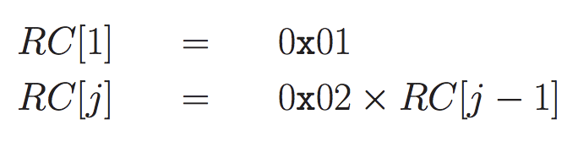
AES – Key Expansion
The only non-zero byte in the round constants, RC[i], obeys the following recursion:
The addition of the round constants is for the purpose of destroying any symmetries that may have been introduced by the other steps in the key expansion algorithm

Slide 26
AES – Key Expansion
A key length of 192 bits entails 12 rounds and a key length of 256 bits entails 14 rounds
However, the length of the input block remains unchanged at 128 bits
The key expansion algorithm must obviously generate a longer schedule
For the 192 bit key it requires 12 rounds
For the 256 bit keys it requires 14 rounds
Keeping in mind how we used the key schedule for the case of a 128 bit key
we are going to need 52 words in the key schedule for the case of 192-bit keys and
60 words for the case of 256-bit keys

Slide 27
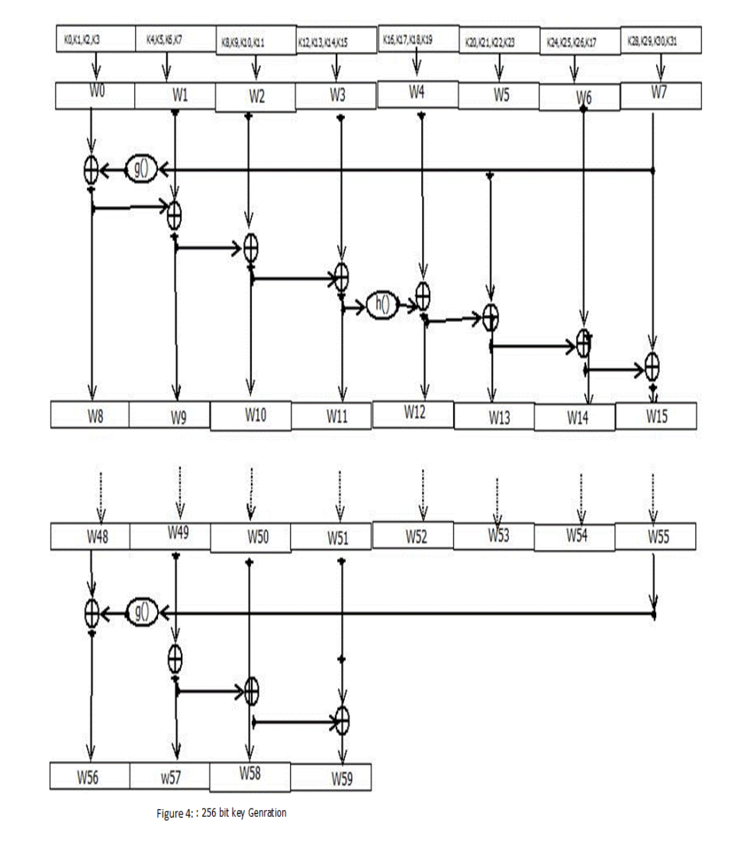
AES – Key Expansion: 256 bits

Slide 28
Attacks on AES
AES is considered a highly secure symmetric cryptosystem
Indeed, the only known practical attacks on AES are side channel attacks
a side-channel attack is any attack based on information gained from the implementation of a computer system, rather than weaknesses in the implemented algorithm itself
A side channel attack on AES is timing attack
Variations of such an attack were independently discovered in 2005 by Bernstein and by Osvik, Shamir, and Tromer
Recall that to speed up the running time of AES, the algorithm is implemented using lookup tables
The timing attack is based on the fact that the cache of the processor where the AES algorithm is executed will store portions of the lookup tables used in the implementation of AES

Slide 29
Attacks on AES
Thus, the time it takes to execute the algorithm provides information about how the lookup tables are accessed
By timing multiple executions of the algorithm using the same key on a series of known plaintexts of known ciphertexts, the attacker can eventually learn the key
If the attacker is on the same system where AES is executed, the key can be recovered in less than a second
If the attacker and the AES computation are on different machines, recovering the key takes several hours
To defend against timing attacks, AES should be implemented in a way that the execution time remains constant, irrespective of the cache architecture

Slide 30

The lecture slides can be found in the following location!

